Slide 1
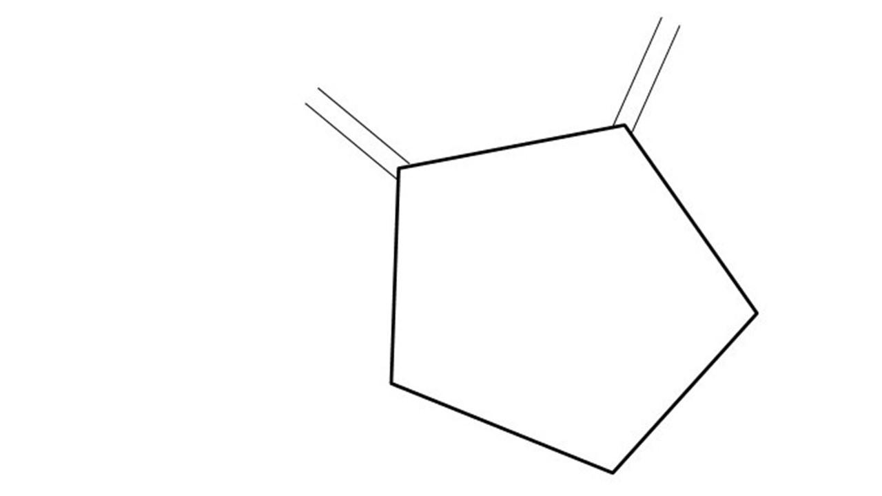


Great Cow BASIC Part 7
Great Cow BASIC for the PIC16F171xx chip Family
Oct 2022

Slide 2
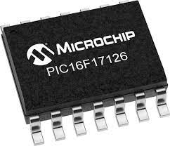
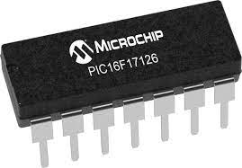
PIC16F171xx
PIC16F171xx is a high performance PIC16
Digital and Analog peripherals
12-bit ADC
Multiple communication interfaces
Serial, I2C, SPI
PWM – CCP/PWM and 16Bit
Configurable Logic Cells
OpAmp
The PIC16F171xx offers 8 to 20 pin products in small footprint packages to support customers in a variety of space constrained and sensor node applications.

Slide 3
Videos...
Install the hardware and make the board work – three LED programs
Make four LEDs flash in a sequence
Set the LEDs to represent the value of ADC
Sequence the LEDs with a delay using the value of ADC
Using an input to set the state of the LED
Using the reset switch
Using the switch, ADC – make the LEDs flash in a sequence with reverse
Using the serial to display values
Using the timer0 overflow, 8bit timer, 16bit timer to flash the LEDs
Using CCP/PWM to dim the LEDS
Using I2C with serial to discover I2C devices
Using EEProm – showing values on the serial terminal
Using an I2C GCLD display
Using an SPI GCLD display
Using PWM to dim the LEDS
Using memory within the PIC – Progmem and SAF memory
The Great Cow BASIC tool chain
Assembly and alternatives assemblers
Summary

Slide 4
Great Cow BASIC Compiler
Great Cow BASIC is an Open Source compiler for Microchip PIC &AVR and Logic Green AVR microcontrollers
Great Cow BASIC now supports the 16F171xx chip family
Great Cow BASIC Compiler

Slide 5
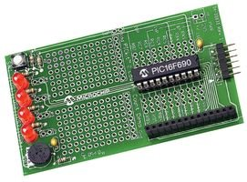
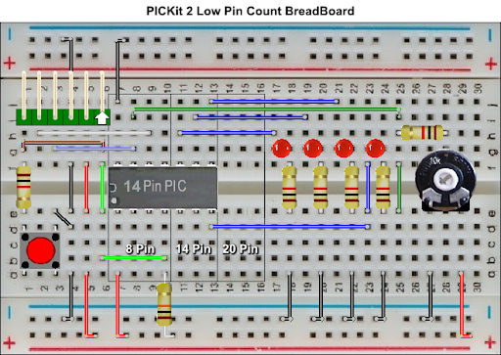

Hardware
Microchip Low Pin Count Demo Board
PICKit_2_Low_Pin_Count_User_Guide_51556a.pdf
By Chris Roper

Slide 6
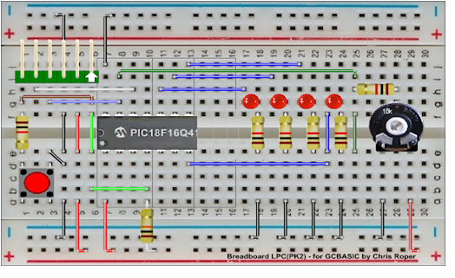
Hardware
Layout
16F17126
By Chris Roper

Slide 7
Pulling it all together
Outputs
LEDs rotating in sequence
Input
Switch to control direction of sequence
Using Master Clear as an input NOT as a reset
ADC
Read the voltage from the potentiometer
Time
Using WAIT that consistent across all mcu frequency

Slide 8
Tutorial overview
Initialise
Flash an LED
Initialise
Do forever
Read ADC – an 8-bit read
Determine if switch state changed
Set state of LEDs
Wait
Loop
Do Forever
ReadADC
Switch state changed
Right
Left
Set State of LEDs
Set State of LEDS
Wait

Slide 9
Lab
Examine the sample code
Review the results
Change the microcontroller !!
Portable code
Revert the code

Slide 10
GCStudio Auto Update
Maintains a consistent tool chain
Options
Automatic
Off

Slide 11




Slide 13
Videos...
Install the hardware and make the board work – three LED programs
Make four LEDs flash in a sequence
Set the LEDs to represent the value of ADC
Sequence the LEDs with a delay using the value of ADC
Using an input to set the state of the LEDs
Using the reset switch
Using the switch, ADC – the LEDs flash in a sequence with reverse
Using the serial to display values
Using the timer0 overflow, 8bit timer, 16bit timer to flash the LEDs
Using CCP/PWM to dim the LEDS
Using I2C with serial to discover I2C devices
Using EEProm – showing values on the serial terminal
Using an I2C GCLD display
Using an SPI GCLD display
Using PWM to dim the LEDS
Using memory within the PIC – Progmem and SAF memory
The Great Cow BASIC tool chain
Assembly and alternatives assemblers
Summary

Slide 14
Great Cow BASIC
Great Cow BASIC for the PIC18FxxQ41 chip Family
January 2021

Slide 16
Backup Slides

Slide 17
Initialise
Set 1st LED
Wait for a Delay
Rotate the LEDs
Did it overflow ?
No
Yes
Set 1st LED

